Slide 1

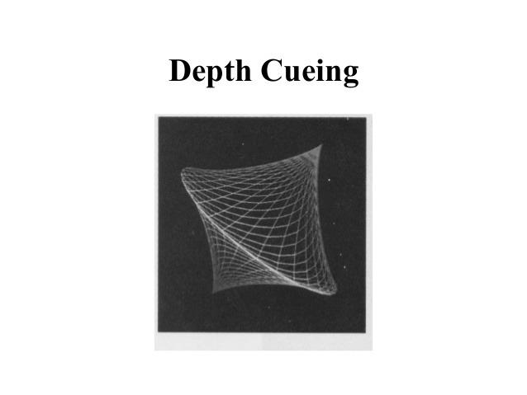
Computer Graphics
Deep Cueing and Visible Line/Surface Identification
Lecture-14
Md. Mahabul Alom Santo Lecturer Department of Computer Science and Engineering Daffodil International University, DIU

Slide 2

What is Depth Cueing?
Deep Cueing is a technique in computer graphics used to show distance (depth) in a scene. Our brains use visual clues—such as relative size, overlapping objects, and perspective—to interpret distance and spatial relationships.
Example:
Imagine you are looking at trees on a long road
The trees near you look dark and clear.
The trees far away look lighter and less clear.

Slide 3

Where use Depth Cueing?
Create Realistic Visuals
Improve Understanding
They help us see and understand three-dimensional shapes and spatial relationships from two-dimensional drawings or images.
Enables viewers to grasp complex spatial arrangements, object positions, and distances more intuitively than a flat image alone could convey.
Video Games & VR
Unity and Unreal automatically apply depth cueing to improve depth perception in fast-moving scenes.

Slide 4
What is Visible Line/Surface Identification?
This technique determines which edges and faces of a 3-D model are actually visible from the camera's viewpoint, ensuring realistic rendering.
Clearly delineates the edges (lines) and faces (surfaces) of objects within a three-dimensional representation, establishing where forms begin and end.
How It Works
Back-Face Culling: The system checks the direction of a surface. If the surface is facing away from the viewer, it is not drawn because it cannot be seen.
Z-Buffer: Each pixel keeps a depth value (distance). When a new pixel appears, the system compares the depth and shows only the closest one.
Scan-line optimisation: Modern GPUs divide the screen into small blocks (tiles) and check depth for each block. This reduces memory use and makes rendering faster.

Slide 5
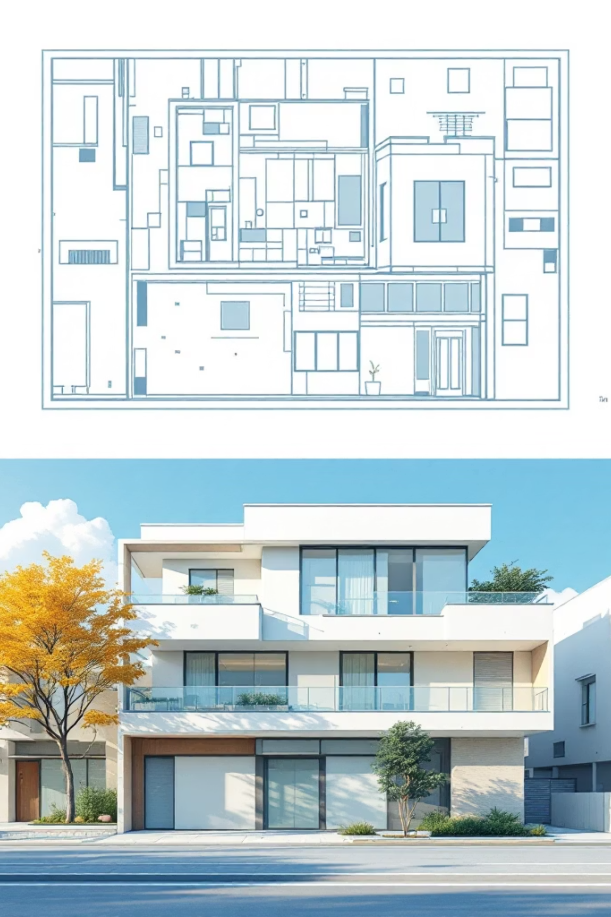


Why Do We Use These Techniques?
Understanding 3D
Space
Creating Realism
Artists and designers use these techniques to make their work look more lifelike and believable to viewers.
They help us see and understand three-dimensional shapes and spatial relationships from 2D images.
Clear Communication
In engineering and architecture, these visual cues are vital for communicating design intentions clearly and accurately.

